Slide 1
COVID-19 Management: Preparation & Response
Mayur Hooli
Mason Jerome

Slide 2
Problem Statement
COVID-19 has become the deadliest pandemic in over 100 years. With a shortage of available medical supplies, the have to be put the best use possible. To do this, policymakers need to know how to best allocate resources and mitigate the spread of COVID-19 through lockdowns or similar measures.
This can be done through our COVID-19 Management System.

Slide 3

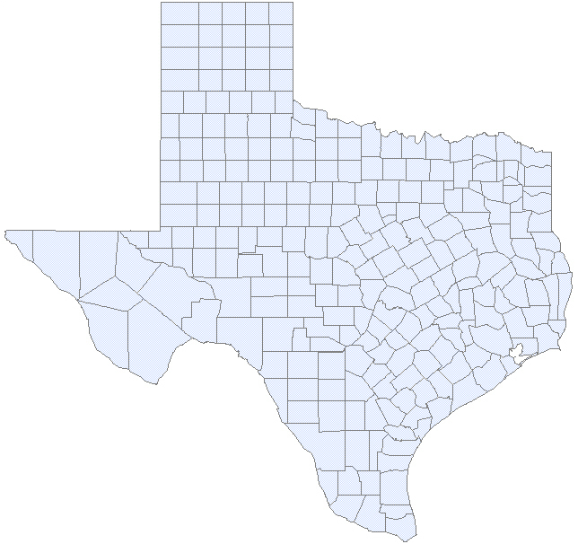
What does it do?
The COVID-19 Management is an intelligent system which identifies the critical areas (case study: Texas) where certain actions need to be taken
This system also ranks the counties based on the risk they pose of spreading the virus to neighboring counties

Slide 4
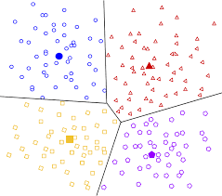
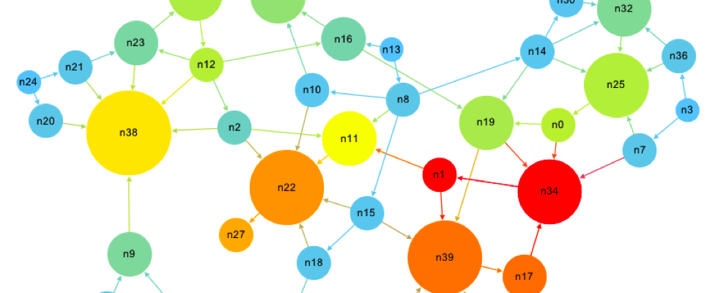
How is this done?
This idea implements clustering alongside the PageRank algorithm
Clustering identifies 4 distinct clusters based on the data set we prepared
PageRank algorithm uses the clustering prediction to identify which counties risk spreading the virus further

Slide 5

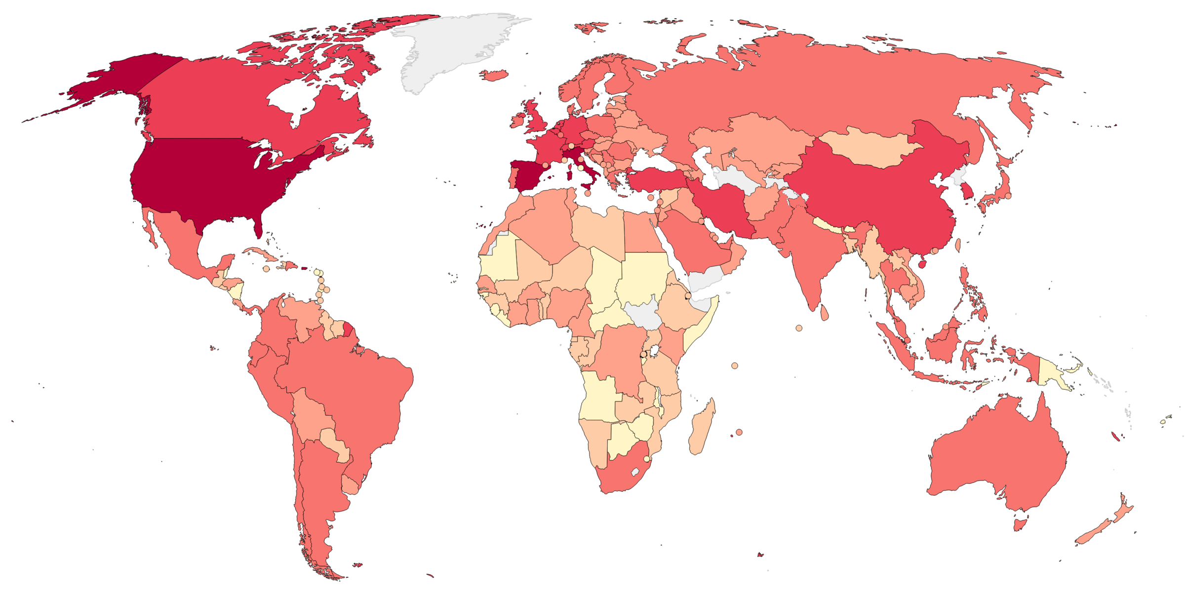
Why is this done?
There is a shortage of medical personnel and testing kits, the categorization of counties helps in effective allocation of resources
The prediction of future affected counties will help in better preparedness to mitigate the virus.

Slide 6
Diagram of Code
County Name
Population
Households
Population Distribution
Population Density
Health Index
Travel Index
COVID-19 Cases
COVID-19 Deaths
Stay At Home Order
Clustering
Nearly no risk
Some Risk
Significant Risk
DANGER!
Page Rank Algorithm
Risk of Spreading the virus to other Counties

Slide 7
Results
County | COVID-19 | Labels
Aransas | 2 | Enjoy Spring a bit
Archer | 0 | Enjoy Spring a bit
Austin | 2 | Enjoy Spring a bit
Bandera | 0 | Enjoy Spring a bit
Baylor | 0 | Enjoy Spring a bit
County | COVID-19 | Labels
El Paso | 40 | Don't Enjoy Spring
Hidalgo | 28 | Don't Enjoy Spring
Wichita | 28 | Don't Enjoy Spring
Nueces | 22 | Don't Enjoy Spring
Cameron | 20 | Don't Enjoy Spring
County | COVID-19 | Labels
Travis | 200 | Stay Inside
Denton | 165 | Stay Inside
Collin | 134 | Stay Inside
Fort Bend | 119 | Stay Inside
Galveston | 70 | Stay Inside
County | COVID-19 | Labels
Bexar | 157 | DANGER!
Dallas | 488 | DANGER!
Harris | 526 | DANGER!
Tarrant | 139 | DANGER!
Page Rank Algorithm
Dallas County
Gillespie County
Wheeler County
Novelty
Everyone around the world is trying to figure out how to fight coronavirus
The novel approach of using Clustering and Page Rank together would help us understand where the risk lies
Following the results given by this algorithm would help manage the fight against the pandemic

Slide 8

Future Work
Extend this algorithm to the whole country by collecting data from all counties
Use the GIS to identify the zones on the map for better visualization
Collect more relevant parameters to identify the spread of the virus
Create a similar model for pandemic response and disaster response to help manage similar situations in the future
Help humanity

Slide 9
Thank You!

